Slide 1
Signal Analysis and Transmission Course Teacher Dr. Monir Morshed Professor, Dept. of ICT Email:monirmorshed.ict@mbstu.ac.bd

Slide 2
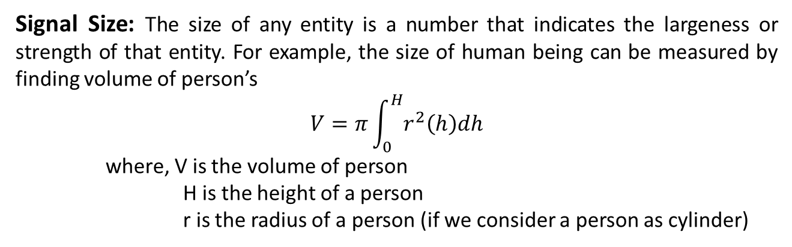
Signals
Signal: A signal is a function of one or more independent variables which contains a set of information or data. Some examples of signals are:
A telephone or Television signals
Radio signal
Computer signal. Etc.
Signal Size: The size of any entity is a number that indicates the largeness or strength of that entity. For example, the size of human being can be measured by finding volume of person’s
$$V=π\int_{0}^{H}{r^{2}\left(h\right)dh}$$
where, V is the volume of person
H is the height of a person
r is the radius of a person (if we consider a person as cylinder)

Slide 3
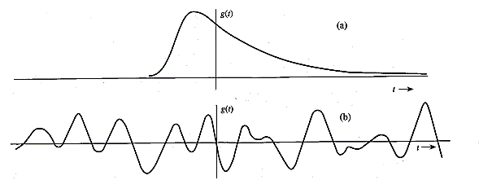
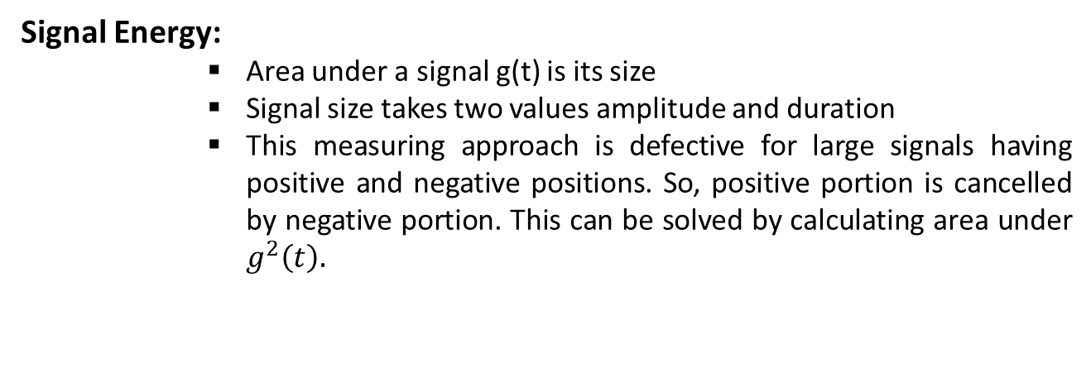
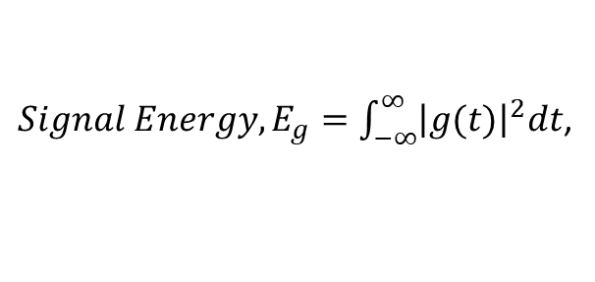
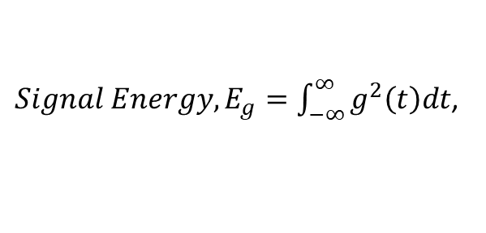
Signals
Signal Energy:
Area under a signal g(t) is its size
Signal size takes two values amplitude and duration
This measuring approach is defective for large signals having positive and negative positions. So, positive portion is cancelled by negative portion. This can be solved by calculating area under $g^{2}\left(t\right).$
$Signal Energy, E_{g}=\int_{−∞}^{∞}{g^{2}\left(t\right)dt}$,
For a real signal
$Signal Energy, E_{g}=\int_{−∞}^{∞}{{\left|g(t)\right|}^{2}dt}$,
For a complex signal

Slide 4
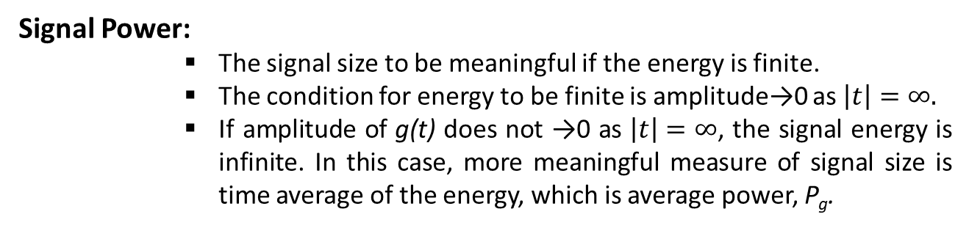


Signals
Signal Power:
The signal size to be meaningful if the energy is finite.
The condition for energy to be finite is amplitude→0 as $\left|t\right|=∞.$
If amplitude of g(t) does not →0 as $\left|t\right|=∞$, the signal energy is infinite. In this case, more meaningful measure of signal size is time average of the energy, which is average power, P_{g}.
$Signal Power, P_{g}=\int_{−T/2}^{T/2}{g^{2}\left(t\right)dt}$,
For a real signal
$Signal Power, P_{g}=\int_{−T/2}^{T/2}{{\left|g(t)\right|}^{2}dt}$,
For a complex signal

Slide 5
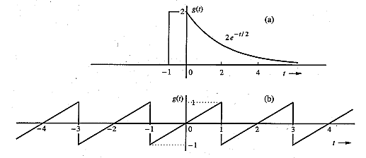

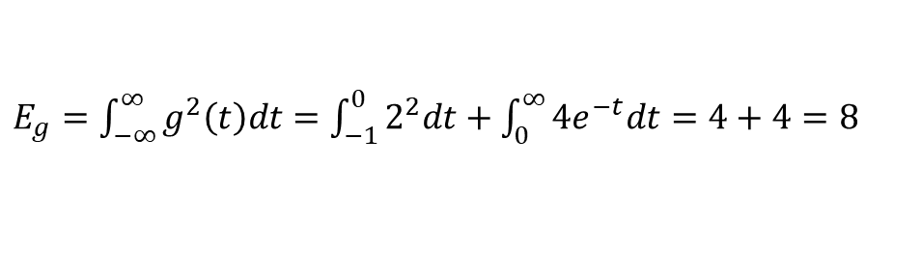
Example
Determine the suitable measures of the signal in the following figure:
For a figure (a), amplitude→0 as $\left|t\right|=∞.$ Therefore, suitable measure of this signal is its energy, E_{g.}
$E_{g}=\int_{−∞}^{∞}{g^{2}\left(t\right)dt}=$ $\int_{−1}^{0}{2^{2}dt+\int_{0}^{∞}{{4e}^{−t}dt=4+4=8}}$
For a figure (b), amplitude does not→0 as $\left|t\right|=∞.$ Therefore, suitable measure of this signal is its power, P_{g.}
$P_{g}=\int_{−T/2}^{T/2}{g^{2}\left(t\right)dt}$= $\int_{−1}^{1}{t^{2}dt=\frac{1}{3}}$

Slide 6
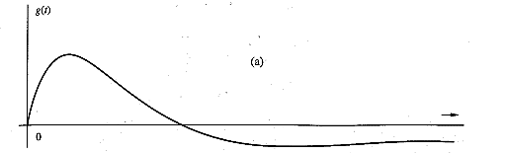
Signals
Signal Classification: Signals are classified into the following categories:
Continuous Time and Discrete Time Signals
Analog and Digital Signals
Deterministic and Non-deterministic Signals
Even and Odd Signals
Periodic and Aperiodic Signals
Energy and Power Signals
Real and Imaginary Signals
Continuous-time Signal: A signal is said to be continuous when it is defined for all instants of time.

Slide 7
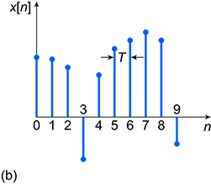
Signals
Discrete-time Signal: A signal is said to be discrete when it is defined at only discrete instants of time.

Slide 8
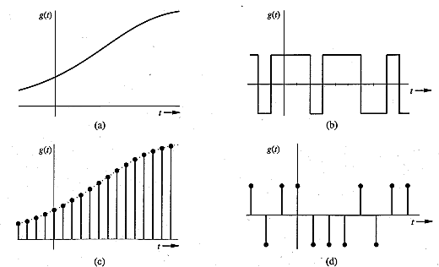
Signals
Analog Signals: A signal whose amplitude can take on any value in a continuous range is an analog signal. This means that an analog signal amplitude can take an infinite number of values.
Digital Signals: A digital signal has only finite a finite number of values.

Slide 9
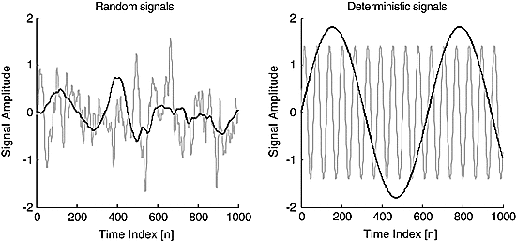
Signals
Deterministic Signal: A signal is said to be deterministic if there is no uncertainty with respect to its value at any instant of time. Or, signals which can be defined exactly by a mathematical formula are known as deterministic signals
Non-deterministic Signal: A signal is said to be non-deterministic if there is uncertainty with respect to its value at some instant of time. Non-deterministic signals are random in nature hence they are called random signals.

Slide 10
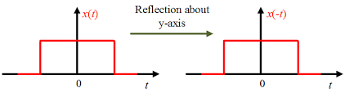
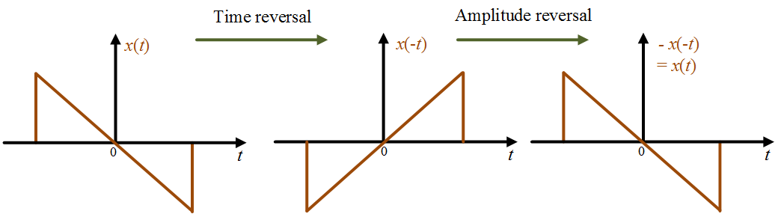
Signals
Even Signal: A signal is said to even signal when it satisfies the condition x(t) = x(-t).
Odd Signal: A signal is said to be odd when it satisfies the condition x(t) = -x(-t).

Slide 11
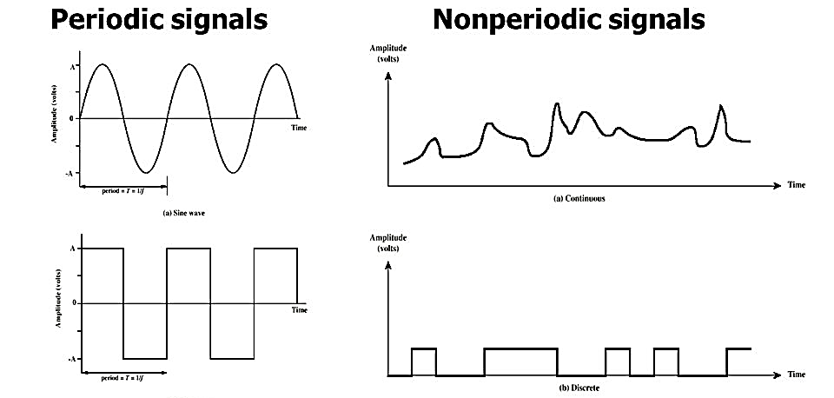
Signals
Periodic Signal: A signal is said to be periodic if it satisfies the condition x(t) = x(t + T).
Aperiodic Signal: A signal is said to be periodic if it does not repeat.

Slide 12
Signals
Real Signal: A signal is said to be real when it satisfies the condition x(t) = x*(t)
Imaginary Signal: A signal is said to be odd when it satisfies the condition x(t) = -x*(t)
Example:
If x(t)= 3 then x*(t)=3*=3 here x(t) is a real signal.
If x(t)= 3j then x*(t)=3j* = -3j = -x(t) hence x(t) is a odd signal.
Note: For a real signal, imaginary part should be zero. Similarly for an imaginary signal, real part should be zero

Slide 13
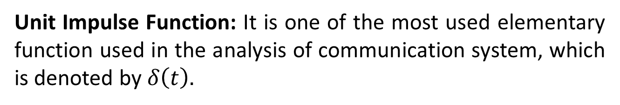

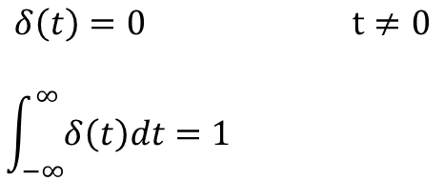
Singularity Functions
Unit Step Function: The unit step function is exist only for positive side and zero for negative side. It is denoted by u(t).
U(t)
$$u\left(t\right)=\left\{\begin{aligned}0 for t<0 \\ 1 for t>0\end{aligned} \right.$$
1
0
t
Unit Impulse Function: It is one of the most used elementary function used in the analysis of communication system, which is denoted by $δ\left(t\right).$
δ(t)
$$δ\left(t\right)=0 t≠0$$
$$\int_{−∞}^{∞}{δ\left(t\right)dt=1}$$
1
0
t

Slide 14

Singularity Functions
Unit Ramp Function: It is a function which starts at t=0 and increases linearly with time. It is denoted by r(t).
r(t)
$$r\left(t\right)=\left\{\begin{aligned}0 for t≤0 \\ t for t≥0\end{aligned} \right.$$
1
0
t

Slide 15
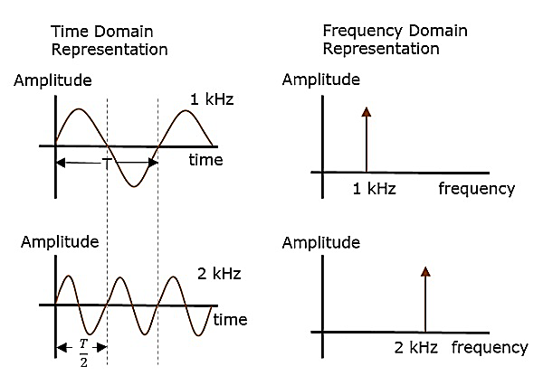
Representation of Signals
Time domain representation: In the time domain representation, a signal is time varying quantity.
Frequency domain representation: In the frequency domain representation, a signal is represented by its frequency spectrum. It is also called line spectrum.

Slide 16
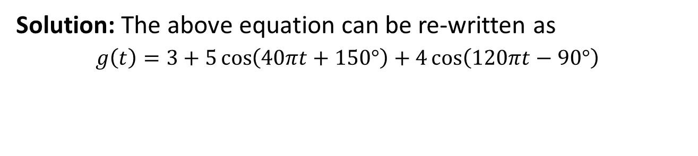

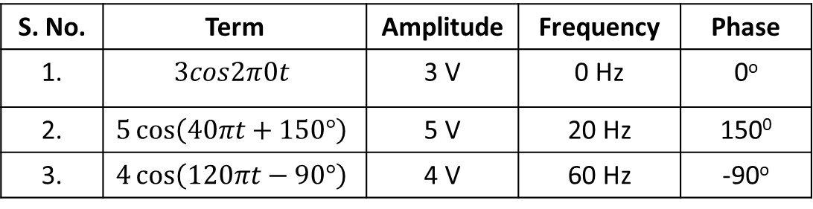
How to plot line spectrum
Sketch the line spectrum of the following signal:
$$g\left(t\right)=3−5\cos\left(40πt−30°\right)+4sin⁡(120πt)$$
Solution: The above equation can be re-written as
$g\left(t\right)=3+5\cos\left(40πt+150°\right)+4\cos\left(120πt−90°\right)$
S. No. | Term | Amplitude | Frequency | Phase
1. | $$3cos2π0t$$ | 3 V | 0 Hz | 0º
2. | $$5\cos\left(40πt+150°\right)$$ | 5 V | 20 Hz | 150⁰
3. | $$4\cos\left(120πt−90°\right)$$ | 4 V | 60 Hz | -90º
5
150º
Amplitude
Phase
4
3
3
0
20
60
f Hz
0
20
60
f Hz
-90º

Slide 17
Double Sided Line Spectrum
If spectrum is represented for both the positive and negative frequency is called double sided line spectrum.
Amplitude
A
A
-f
0
f
f Hz
Phase
φ
-f
0
f
f Hz
-φ

Slide 18
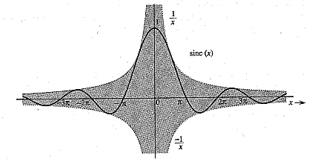
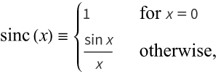
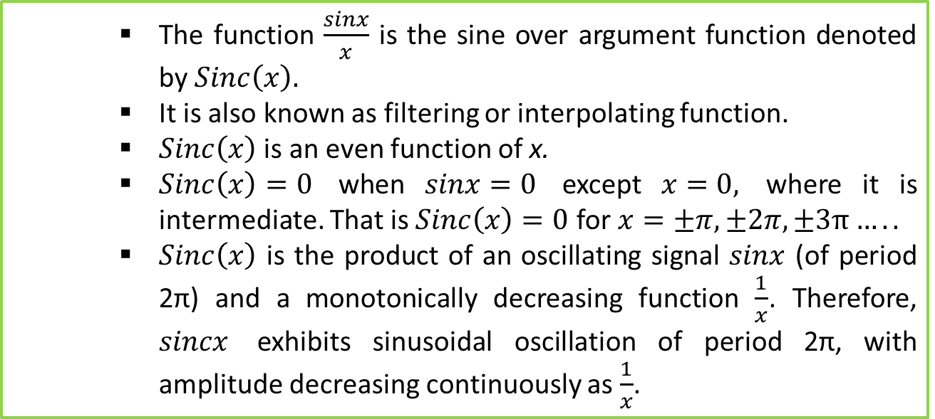
Filtering or Interpolating function
The function $\frac{sinx}{x}$ is the sine over argument function denoted by $Sinc\left(x\right).$
It is also known as filtering or interpolating function.
$Sinc\left(x\right)$ is an even function of x.
$Sinc\left(x\right)=0$ when $sinx=0$ except $x=0,$ where it is intermediate. That is $Sinc\left(x\right)=0$ for $x=±π, ±2π,±3π…..$
$Sinc\left(x\right)$ is the product of an oscillating signal $sinx$ (of period 2π) and a monotonically decreasing function $\frac{1}{x}$. Therefore, $sincx$ exhibits sinusoidal oscillation of period 2π, with amplitude decreasing continuously as $\frac{1}{x}$.

Slide 19
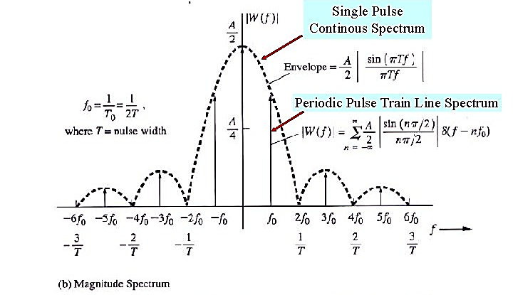
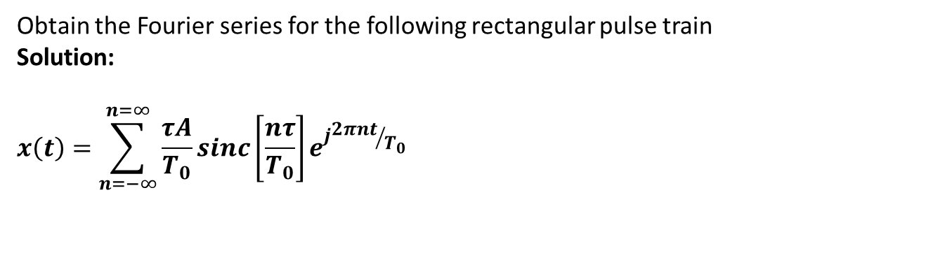
Fourier Series
Fourier series are important for the following reasons:
How many frequency components are present in the signal
Their amplitudes
Their relative phase difference between these frequency component.
Fourier series is used for periodic signals
Obtain the Fourier series for the following rectangular pulse train
Solution:
$$x\left(t\right)=\sum_{n=−∞}^{n=∞}{\frac{τA}{T_{0}}sinc}\left[\frac{nτ}{T_{0}}\right]e^{j{2πnt}/{T_{0}}}$$
x(t)
A
-T₀/2
T₀/2
-T₀
-τ/2
τ/2
T₀
t
T₀

Slide 20
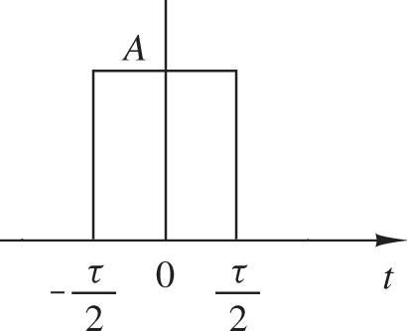
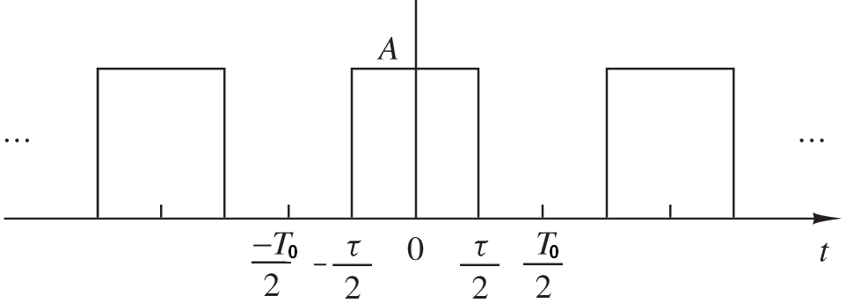
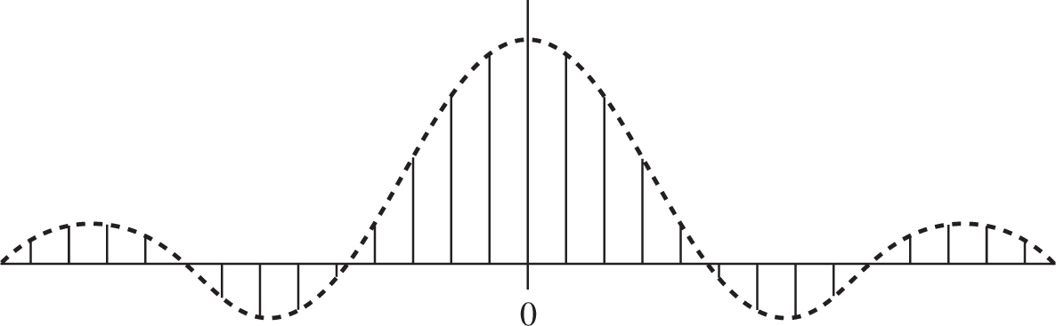
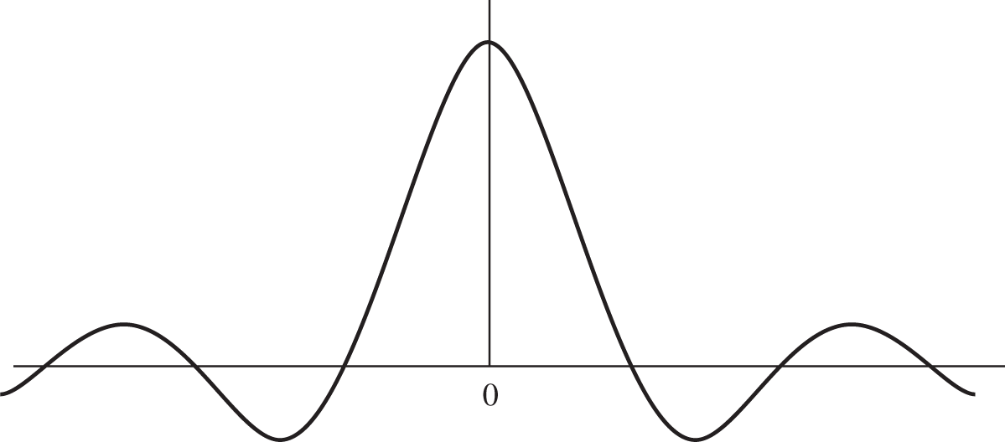
Link between FT and FS
x_{To}(t)
x(t)
x(t ) = lim x (t )
T₀ →∞
T
0
T₀ → ∞ ⇒⇒ ω₀ → 0
As T₀ gets larger and larger the fundamental frequency ω₀ gets smaller and smaller so the spectrum becomes continuous.
D_{n}
D = ¹ X (nω ) X (ω)
n 0
T
0
ω₀
ω

Slide 21
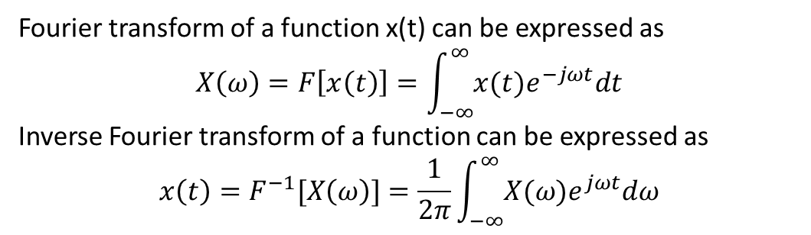
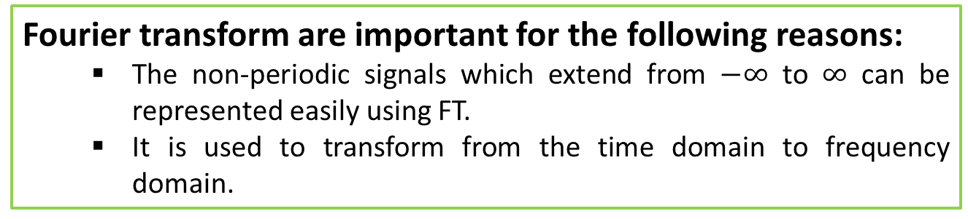
Fourier Transform (FT)
Fourier transform are important for the following reasons:
The non-periodic signals which extend from $−∞$ to $∞$ can be represented easily using FT.
It is used to transform from the time domain to frequency domain.
Fourier transform of a function x(t) can be expressed as
$$X\left(ω\right)=F\left[x\left(t\right)\right]=\int_{−∞}^{∞}{x(t)e^{−jωt}dt}$$
Inverse Fourier transform of a function can be expressed as
$$x\left(t\right)=F^{−1}[X\left(ω\right)]=\frac{1}{2π}\int_{−∞}^{∞}{X(ω)e^{jωt}dω}$$

Slide 22
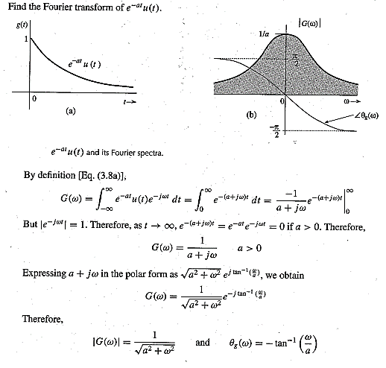
Fourier Transform (FT)
Find the Fourier transform of $e^{−at}u\left(t\right).$

Slide 23
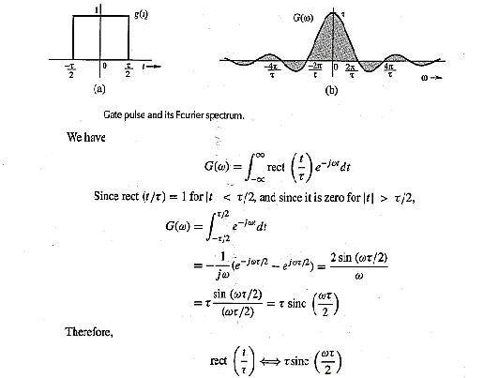
Fourier Transform (FT)
Find the Fourier transform of $g\left(t\right)=rec(\frac{t}{τ})$

Slide 24
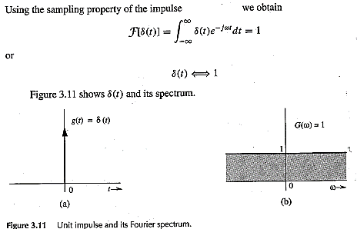
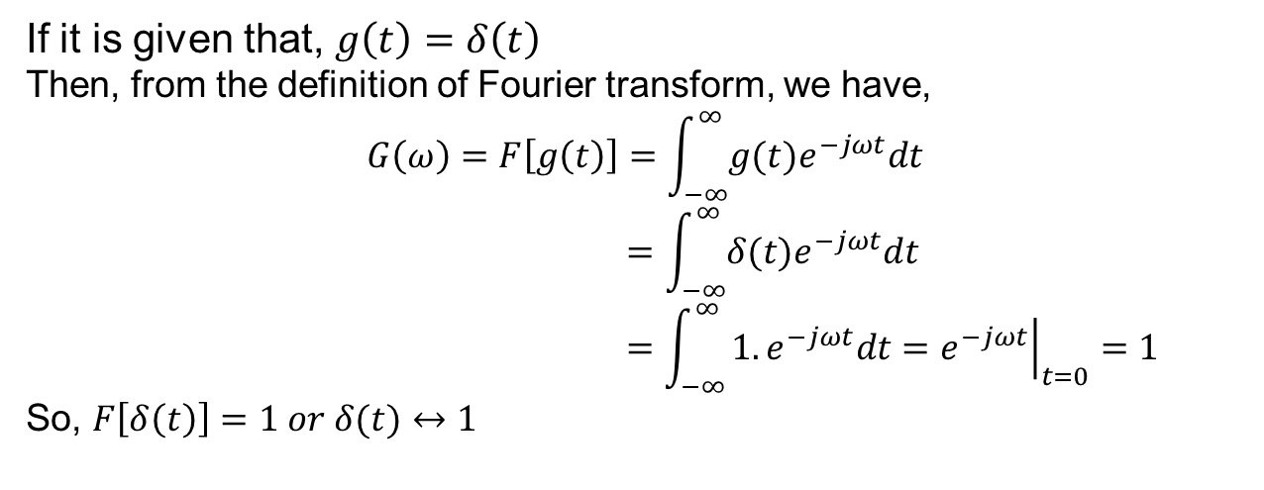
Fourier Transform (FT)
Find the Fourier transform of the unit impulse $δ\left(t\right)=1$
If it is given that, $g\left(t\right)=δ\left(t\right)$
Then, from the definition of Fourier transform, we have,
$$G\left(ω\right)=F\left[g\left(t\right)\right]=\int_{−∞}^{∞}{g(t)e^{−jωt}dt}$$
$$=\int_{−∞}^{∞}{δ(t)e^{−jωt}dt}$$
$$=\int_{−∞}^{∞}{1.e^{−jωt}dt={\left.e^{−jωt}\right|}_{t=0}=1}$$
So, $F\left[δ\left(t\right)\right]=1 or δ(t)↔1$
That is, the Fourier transform of a unit impulse function is unity.

Slide 25
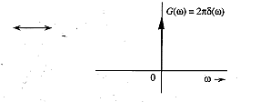
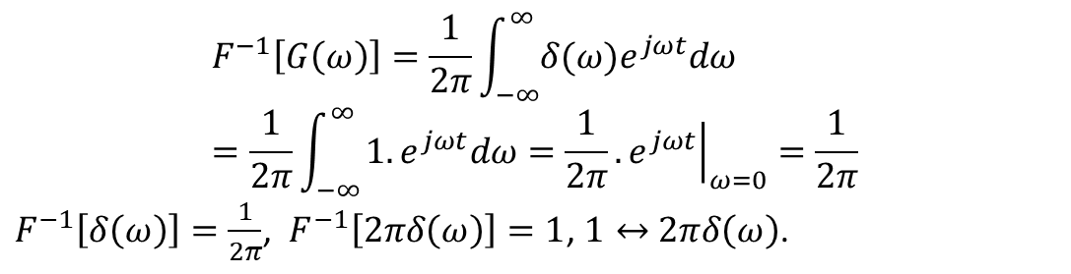

Fourier Transform (FT)
Find the inverse Fourier transform of the unit impulse $δ\left(ω\right)$.
Inverse Fourier transform of a function can be expressed as
$$g\left(t\right)=F^{−1}\left[G\left(ω\right)\right]=\frac{1}{2π}\int_{−∞}^{∞}{G\left(ω\right)e^{jωt}dω}$$
The inverse Fourier transform of G(ω)=1 is determined through inverse Fourier transform of impulse function [δ(ω)].
$$F^{−1}\left[G\left(ω\right)\right]=\frac{1}{2π}\int_{−∞}^{∞}{δ(ω)e^{jωt}dω}=\frac{1}{2π}\int_{−∞}^{∞}{1.e^{jωt}dω=\frac{1}{2π}.{\left.e^{jωt}\right|}_{ω=0}=\frac{1}{2π}}$$
$F^{−1}\left[δ\left(ω\right)\right]=\frac{1}{2π}$, $F^{−1}\left[2πδ\left(ω\right)\right]=1$, $1↔$ $2πδ\left(ω\right)$.

Slide 26
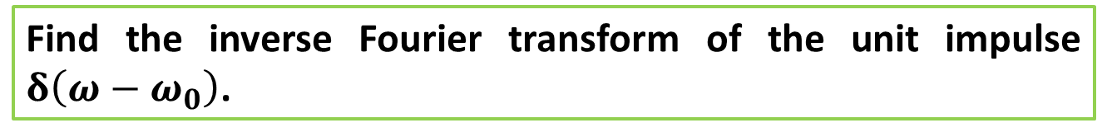
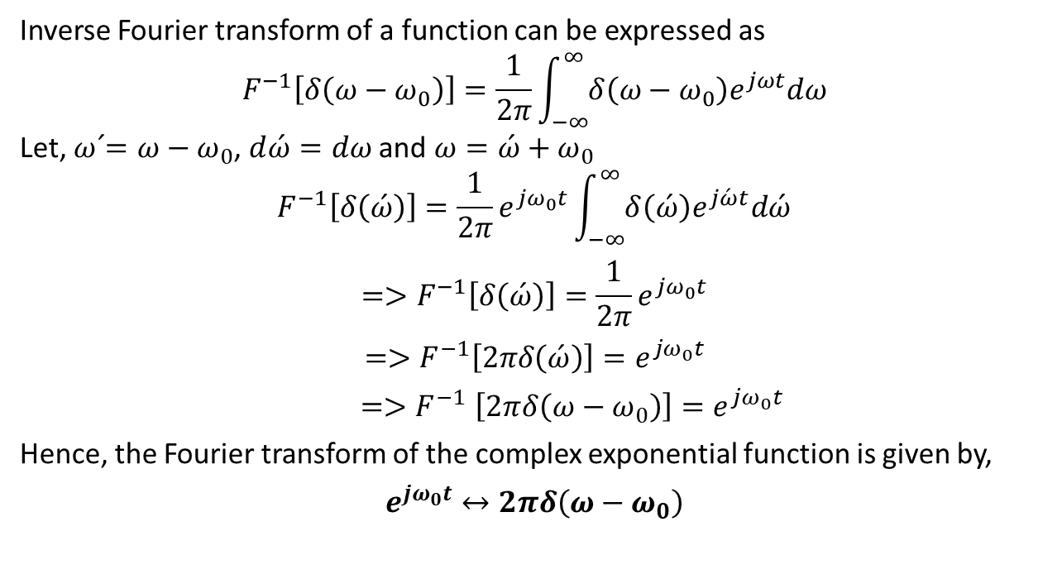
Fourier Transform (FT)
Find the inverse Fourier transform of the unit impulse $δ\left(ω−ω_{0}\right)$.
Inverse Fourier transform of a function can be expressed as
$$F^{−1}\left[δ\left(ω−ω_{0}\right)\right]=\frac{1}{2π}\int_{−∞}^{∞}{δ\left(ω−ω_{0}\right)e^{jωt}dω}$$
Let, $\acute{ω=}ω−ω_{0}$, $d\acute{ω}=dω$ and $ω=\acute{ω}+ω_{0}$
$$F^{−1}\left[δ\left(\acute{ω}\right)\right]=\frac{1}{2π}e^{jω_{0}t}\int_{−∞}^{∞}{δ\left(\acute{ω}\right)e^{j\acute{ω}t}d\acute{ω}}$$
$$=>F^{−1}\left[δ\left(\acute{ω}\right)\right]=\frac{1}{2π}e^{jω_{0}t}$$
$$=>F^{−1}\left[2πδ\left(\acute{ω}\right)\right]=e^{jω_{0}t}$$
${=>F}^{−1}\left[2πδ\left(ω−ω_{0}\right)\right]=e^{jω_{0}t}$
Hence, the Fourier transform of the complex exponential function is given by,
$$e^{jω_{0}t}↔2πδ\left(ω−ω_{0}\right)$$

Slide 27
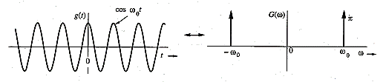
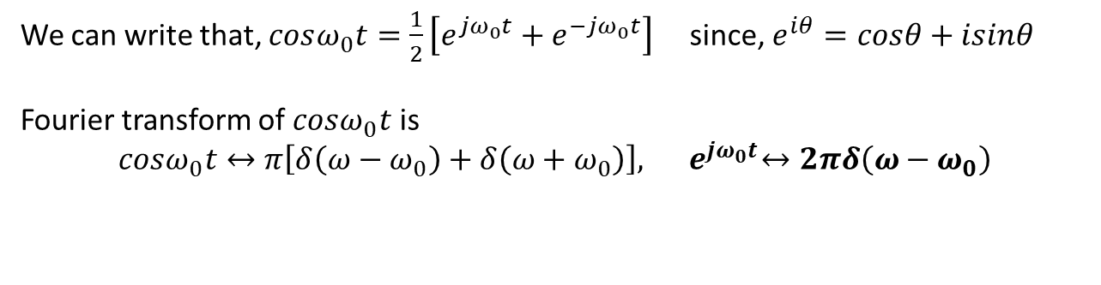
Fourier Transform (FT)
Find the Fourier transform of the everlasting sinusoid $cosω_{0}t$.
We can write that, $cosω_{0}t=\frac{1}{2}\left[e^{jω_{0}t}+e^{−jω_{0}t}\right]$ since, $e^{iθ}=cosθ+isinθ$
Fourier transform of $cosω_{0}t$ is
$cosω_{0}t↔$ $π\left[δ\left(ω−ω_{0}\right)+δ\left(ω+ω_{0}\right)\right], { e}^{jω_{0}t}↔2πδ\left(ω−ω_{0}\right)$
The spectrum of $cosω_{0}t$ consists of two impulses at $ω_{0}$ and ${−ω}_{0}.$

Slide 28
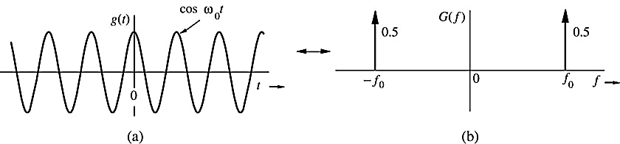
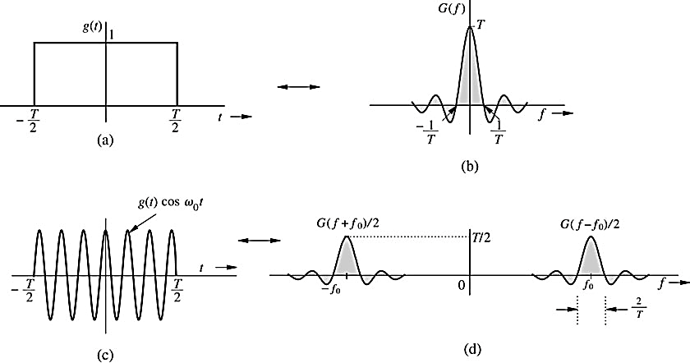
Example: Amplitude Modulation
Example: Find the FT for the signal

Slide 29
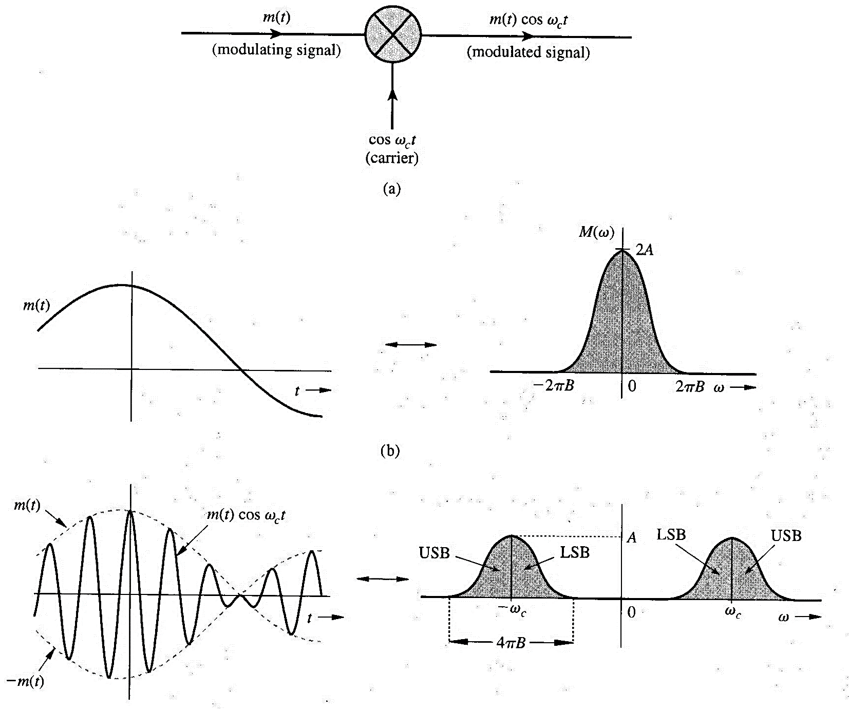
Amplitude Modulation
Modulation
Demodulation
Then lowpass filtering

Slide 30
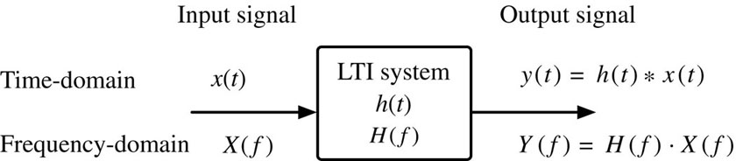
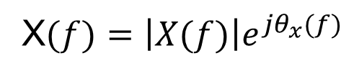

Signal Transmission Through a Linear System

Slide 31
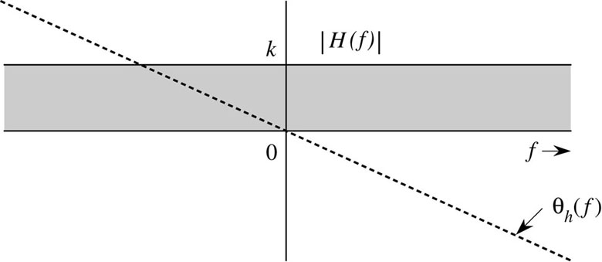

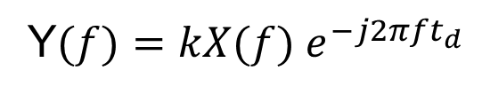
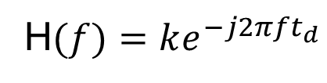


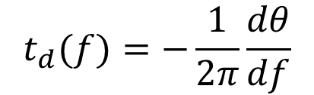

Distortionless Transmission (System)
Slope is constant for distortionless system
group delay

Slide 32




Example 3.16
A transmission medium is modeled by a simple RC low-pass filter shown below. If g(t) and y(t) are the input and the output, respectively to the circuit, determine the transfer function H(f), θ_{h}(f), and t_{d}(f). For distortionless transmission through this filter, what is the requirement on the bandwidth of g(t) if amplitude response variation within 2% and time delay variation within 5% are tolerable? What is the transmission delay? Find the output y(t).
a =1/RC
$$\frac{d}{dx}\left(\tan^{−1}ax\right)=\frac{a}{1+a^{2}x^{2}}$$
Answer: f_{o} = 32.31 kHz

Slide 33






Ideal Versus Practical Filters

Slide 34


Ideal Versus Practical Filters

Slide 35

Digital Filter

Slide 36
Signal Distortion Over a Communication Channel
Linear Distortion
Channel Nonlinearities
Multipath Effects
Fading Channels
- Channel fading vary with time. To overcome this distortion is to use automatic gain control (AGC)

Slide 37




Linear Distortion
Channel causes magnitude distortion, phase distortion, or both.
Example: A channel is modeled by a low-pass filter with transfer function H(f) give by
$$H(f)=\left\{\begin{matrix}\left(1+kcos2πfT\right)e^{−j2πft_{d}^{}} \left|f\right|<B \\ 0 \left|f\right|>B\end{matrix}\right.$$
A pulse g(t) band-limited to B Hz is applied at the input of this filter. Find the output y(t).

Slide 38
Nonlinear Distortion
y(t) = f(g(t))
f(g) can be expanded by Maclaurin series
$$y\left(t\right)=a_{0}+a_{1}g\left(t\right)+a_{2}g^{2}\left(t\right)+…+a_{k}g^{k}\left(t\right)$$
If the bandwidth of g(t) is B Hz then the bandwidth of y(t) is kB Hz.
Example: The input x(t) and the output y(t) of a certain nonlinear channel are related as
y(t) = x(t) + 0.000158 x²(t)
Find the output signal y(t) and its spectrum Y(f) if the input signal is x(t) = 2000 sinc(2000πt). Verify that the bandwidth of the output signal is twice that of the input signal. This is the result of signal squaring. Can the signal x(t) be recovered (without distortion) from the output y(t)?

Slide 39

Continue Example
What is the consequence with this type of distortion if two signals are transmitted in adjacent bands?
Figure 3.36 Signal distortion caused by nonlinear operation: (a) desired (input) signal spectrum;
(b) spectrum of the unwanted signal (distortion) in the received signal; (c) spectrum of the received signal;
(d) spectrum of the received signal after low-pass filtering.

Slide 40



Distortion Caused by Multipath Effects
$$H\left(f\right)=e^{−j2πft_{d}}+αe^{−j2πf{(t}_{d}+∆t)}$$
$$H\left(f\right)=e^{−j2πft_{d}}(1+αe^{−j2πf∆t})$$
$$H\left(f\right)=e^{−j2πft_{d}}(1+α cos2πf∆t−jα sin2πf∆t)$$
$$H\left(f\right)=\sqrt{1+α^{2}+2α cos2πf∆t} exp\left[−j\left(2πft_{d}+\tan^{−1}\frac{α sin2πf∆t}{1+α cos2πf∆t}\right)\right]$$
Common distortion in this type of channel is frequency selective fading

Slide 41







Energy and Energy Spectral Density
$$E_{g}=\int_{−∞}^{∞}{g\left(t\right)g^{∗}\left(t\right)dt}$$
Energy in the time domain
$$E_{g}=\int_{−∞}^{∞}{{\left|G(f)\right|}^{2}df}$$
Energy in the frequency domain
Energy spectral density (ESD), $Ψ_{g}(f)$, is the energy per unit bandwidth (in hertz) of the spectral components of g(t) centered at frequency f.
$$Ψ_{g}(f)={\left|G(f)\right|}^{2}$$
The ESD of the system’s output in term of the input ESD is
$$Ψ_{x}(f)$$
$$H(f)$$
$$Ψ_{y}(f)={\left|H(f)\right|}^{2}Ψ_{x}(f)$$

Slide 42



Essential Bandwidth of a Signal
Estimate the essential bandwidth of a rectangular pulse g(t) = Π(t/T), where the essential bandwidth must contain at least 90% of the pulse energy.
$$E_{g}=\int_{−∞}^{∞}{g^{2}\left(t\right)dt}=\int_{−T/2}^{T/2}{dt=T}$$
$$E_{B}=\int_{−B}^{B}{T^{2}{sinc}^{2}\left(πfT\right)df}=0.9E_{g}$$
Solve the above equation numerically to find B

Slide 43






Energy of Modulated Signals
The modulated signal appears more energetic than the signal g(t) but its energy is half of the energy of the signal g(t). Why?
$$φ\left(t\right)=g\left(t\right) cos2πf_{0}t$$
$$Φ(f)=\frac{1}{2}\left[G\left(f+f_{0}\right)+G(f−f_{0})\right]$$
$$Ψ_{φ}(f)=\frac{1}{4}{\left|G\left(f+f_{0}\right)+G(f−f_{0})\right|}^{2}$$
If f₀ > 2B then
$$Ψ_{φ}\left(f\right)=\frac{1}{4}Ψ_{g}\left(f+f_{0}\right)+{\frac{1}{4}Ψ}_{g}(f−f_{0})$$
$$E_{φ}=\frac{1}{2}E_{g}$$

Slide 44






Time Autocorrelation Function and Energy Spectral Density
The autocorrelation of a signal g(t) and its ESD form a Fourier transform pair, that is
$$ψ_{g}(τ)$$
$$Ψ_{g}(f)$$
$$ψ_{g}\left(τ\right)\overset{⇔}{FT and IFT}Ψ_{g}(f)$$
Note: the autocorrelation of g(t) is the convolution of g(t) with g(-t).
Example: Find the time autocorrelation function of the signal
g(t) = e^{-at}u(t), and from it determine the ESD of g(t).
$$ψ_{g}\left(τ\right)=\int_{−∞}^{∞}{g\left(t\right)g\left(t−τ\right)dt}$$

Slide 45







Signal Power and Power Spectral Density
Power P_{g} of the signal g(t)
$$P_{g}=\lim_{T→∞}{\frac{1}{T}}\int_{−T/2}^{T/2}{g\left(t\right)g^{∗}\left(t\right)dt}$$
$$P_{g}=\lim_{T→∞}{\frac{E_{gT}}{T}}$$
Power spectral density S_{g}(f) of the signal g(t)
$$S_{g}(f)=\lim_{T→∞}{\frac{{\left|G_{T}(f)\right|}^{2}}{T}}$$
$$P_{g}=\int_{−∞}^{∞}{S_{g}\left(f\right)df}=2\int_{0}^{∞}{S_{g}\left(f\right)df}$$
$$S_{x}(f)$$
$$H(f)$$
$$S_{y}(f)={\left|H(f)\right|}^{2}S_{x}(f)$$

Slide 46




Time Autocorrelation Function of Power Signals
Time autocorrelation $ℛ_{g}(τ)$ of a power signal g(t)
$$ℛ_{g}(τ)=\lim_{T→∞}{\frac{1}{T}}\int_{−T/2}^{T/2}{g\left(t\right)g(t−τ)dt}$$
$$ℛ_{g}(τ)=\lim_{T→∞}{\frac{1}{T}}\int_{−∞}^{∞}{g_{T}(t)g_{T}(t+τ)dt}$$
$$ℛ_{g}(τ)=\lim_{T→∞}{\frac{ψ_{gT}(τ)}{T}}$$
$$ℛ_{g}(τ)\overset{⇔}{FT and IFT}S_{g}(f)$$

Slide 47
Autocorrelation a Powerful Tool
If the energy or power spectral density can be found by the Fourier transform of the signal g(t), then why do we need to find the time autocorrelation?
Ans: In communication field and in general the signal g(t) is not deterministic and it is probabilistic function.

Slide 48

Example
A random binary pulse train g(t). The pulse width is T_{b}/2, and one binary digit is transmitted every T_{b} seconds. A binary 1 is transmitted by positive pulse, and a binary 0 is transmitted by negative pulse. The two symbols are equally likely and occur randomly. Determine the PSD and the essential bandwidth of this signal.
1
1
0
1
0
0
1
0
Challenge: g(t) is not deterministic and can not be expressed mathematically to find the Fourier transform and PSD. g(t) is probabilistic (almost random) signal.

Slide 49











$$ℛ_{g}(τ)=\lim_{T→∞}{\frac{1}{T}}\int_{−T/2}^{T/2}{g\left(t\right)g(t−τ)dt}$$
T_{b}
g(t)
t
$$τ$$
g(t-τ)
$$For 0<τ<T_{b}/2$$
$$0$$
$Let T=NT_{b}$ and solve the above integral.
$$ℛ_{g}\left(τ\right)=\lim_{N→∞}\frac{1}{NT_{b}}\left(\frac{T_{b}}{2}−τ\right)N=\left(\frac{1}{2}−\frac{τ}{T_{b}}\right)$$
$$For τ>T_{b}/2$$
$$ℛ_{g}\left(τ\right)=0$$
$$S_{g}\left(f\right)=\frac{T_{b}}{4}{\text{sinc}}^{2}\left(\frac{πfT_{b}}{2}\right)$$

Slide 50












Discrete Fourier Transform (DFT, FFT)
$$G\left(f\right)=\int_{−∞}^{∞}{g(t)e^{−j2πft}dt}$$
$$f_{s}=\frac{1}{T_{s}}≥2B$$
$$N_{0}=\frac{T_{0}}{T_{s}}$$
$$G(qf_{0})=\sum_{k=0}^{N_{0}−1}{g(kT_{s})e^{−j{2πqf}_{0}kT_{s}}}$$
$$G_{q}=\sum_{k=0}^{N_{0}−1}{g_{k}e^{−jqΩ_{0}k}}$$
$$Ω_{0}=\frac{2π}{N_{0}}$$

Slide 51
















Homework Problem
$$ℛ_{g}(τ)=\lim_{T→∞}{\frac{1}{T}}\int_{−T/2}^{T/2}{g\left(t\right)g(t−τ)dt}$$
$$T_{b}/2<τ<T_{b}$$
$$(k+1)T_{b}$$
$$τ$$
$$kT_{b}$$
$$kT_{b}+τ+T_{b}/2$$
$$kT_{b}+τ$$
$$ℛ_{g}\left(τ\right)=\lim_{N→∞}\frac{1}{NT_{b}}\left(kT_{b}+τ+\frac{T_{b}}{2}−(k+1)T_{b}\right)\frac{N}{4}$$
$$ℛ_{g}\left(τ\right)=\frac{1}{4}\left(\frac{τ}{T_{b}}−\frac{1}{2} \right)$$
$$ℛ_{g}\left(τ\right)$$
1$/8$
$${−T}_{b}$$
$${−T}_{b}/2$$
$$T_{b}/2$$
$$T_{b}$$

Slide 52
4nhshwu

